Slide 1


Hourly Wages
Riley James, Tiffany Le, Jake McCoy and Paige O’Connell

Slide 2
Executive Summary
Problem
How do education level, gender, and race affect a person’s hourly wage? Performing this analysis will help others better understand which of the three factors have the biggest impact and which has the smallest impact on hourly wages in the USA.
Data Source
Wages by Education from Kaggle
Methods
Multi – linear regression model, collinearity, and r^2 analysis
Measures
Conclusions
Variable data, p-values of the data, multicollinearity/correlation
We found that the variable with the greatest impact on a person’s hourly wage was their education level. The variable with the least impact on a person’s hourly wage was their race.

Slide 3
Problem Statement – What are we going to solve?
Big Question:
How do education level, gender, and race affect a person’s hourly wage?
Analytical Questions:
Which factors among education level, gender, and race have the greatest impact on a person’s hourly wage?
Which factor is least impactful on a person’s hourly wage?

Slide 4
Problem Statement – How are we going to solve it?
Independent Variable:
Dependent Variables :
Education level
Race
Strategy:
Develop a multi-variable regression model with each dependent variable to determine how each factor impacts hourly wage.
Hourly Wages
Gender

Slide 5

Problem Statement – What are our Assumptions?
The timeframe we will use is the financial data regarding 2022 salaries.
The data we are looking at is coming from the USA.
The three factors we will primarily focus on are education level, gender, and race.
The levels of education will include less than a high school degree, high school degree, some college, bachelor’s degree, and advanced degree (anything above a bachelor’s).
The two genders will be male and female.
The three races we will be analyzing are white, black, and Hispanic.

Slide 6

Data
Dataset:
Kaggle Wages by Education
Variables used: gender, race, and education level
Imported data into an Excel file
Limitations:
Not all degrees provide the same opportunities.
For example, a philosophy degree does not provide as many internships or work experiences as someone with a finance degree. The work that they do also heavily impacts how much they are paid. A teacher’s average hourly pay is around $30, whereas a financial consultant’s average hourly pay is nearly $50.
Not all institutions are created equal.
Geographic location plays a large part in the quality of education provided to students

Slide 7
Methodology – Data Preparation
Narrowed down our data to only 2022 salary wages
Filtered out any data that did not contain all 3 variables: gender, race, and education
Separated the categories for each variable
Gender : Male and Female
Race : White, Black, and Hispanic
Education : Less than high school, high school, some college, bachelor’s degree, advanced degree
Created dummy variables for each variable
Ran regression to determine base case and remove the category with the highest p – value until there is one left

Slide 8
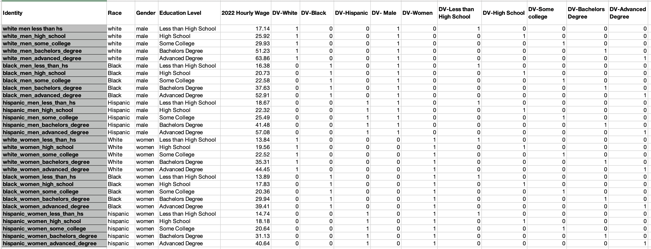
Data with dummy variables created

Slide 9
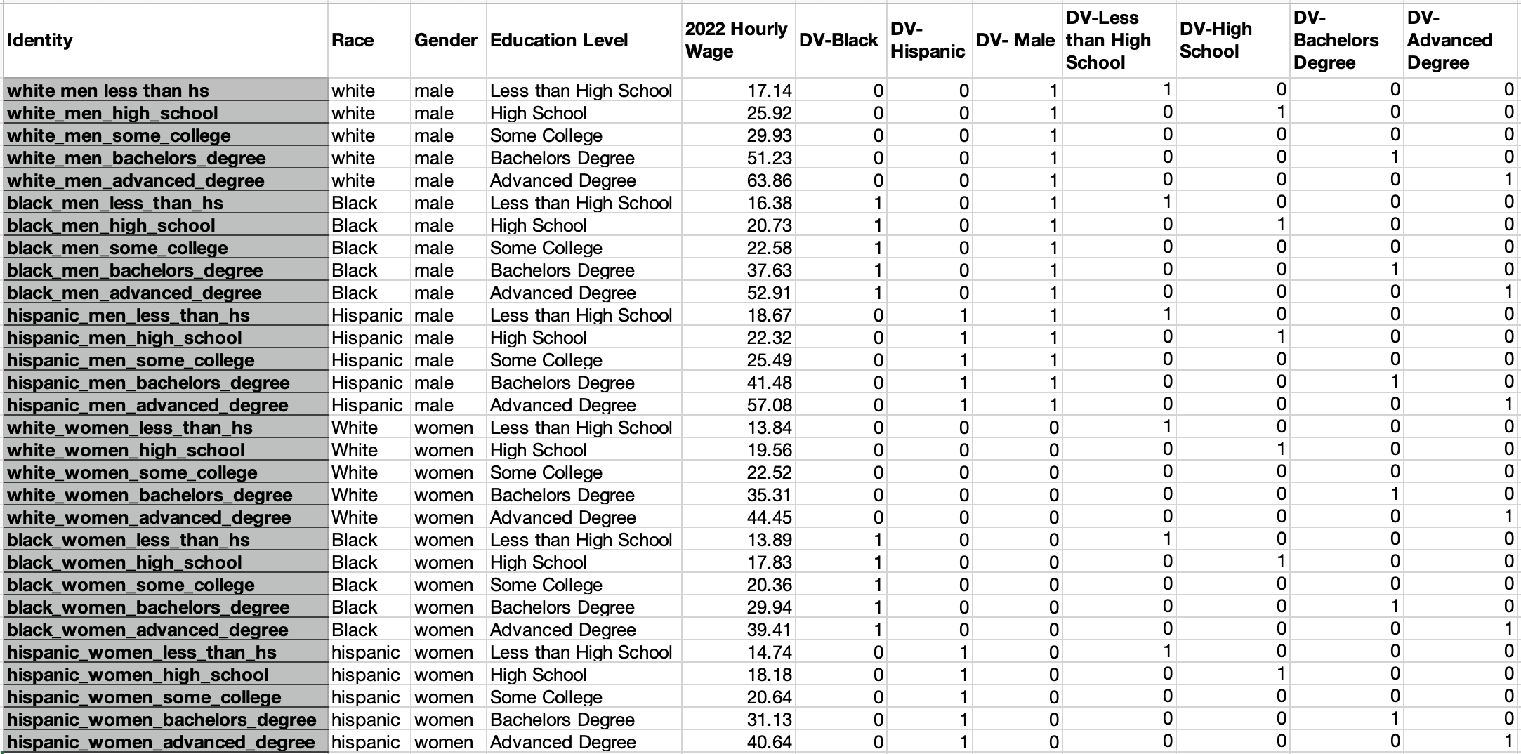
Data with no base cases included
Notes:
Data with base cases removed. The base cases were women, White, and some college.

Slide 10
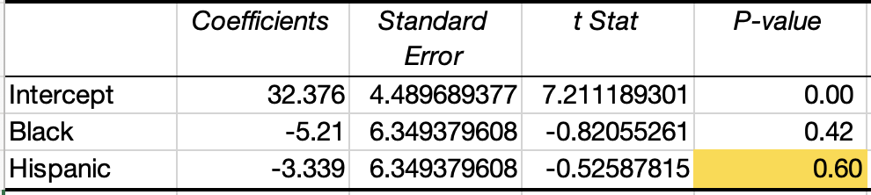
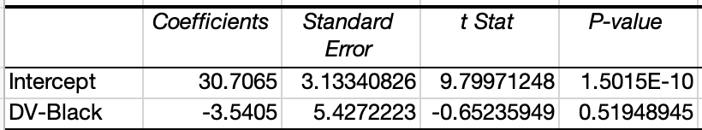
Regression for Race
Regression with black and Hispanic
White was the base case
Ran regression with hourly wage as our y and our x variables were black and Hispanic
We then removed Hispanic as it resulted in the greatest p-value, 0.60 which meant it was not significant
We then did another regression with hourly wage as our y and black as our x
We found that when you are black, you make $3.54 less relative to White and Hispanic people
Regression with black only

Slide 11
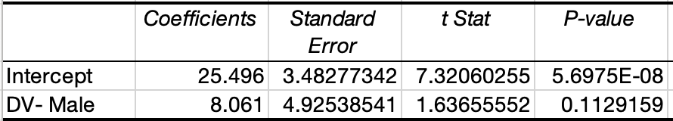
Regression for Gender
Female was the base case
We did a simple regression with hourly wage as our y and men as our x
We found that men make $8.06 more relative to women
Regression with male

Slide 12
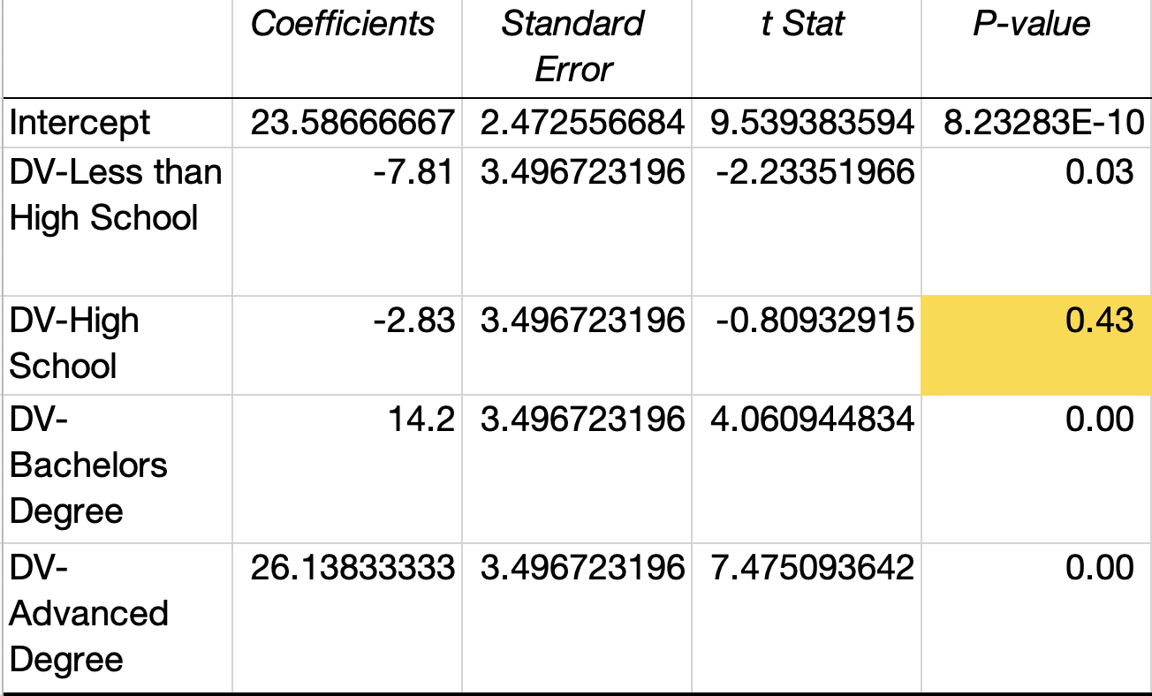
Regression for Level of Education
Regression with less than high school, high school, bachelors and advanced degree
Some college was the base case
We then ran a multi-regression with the remaining 4 variables
We then removed high school as it gave us the highest p-value of -0.43

Slide 13
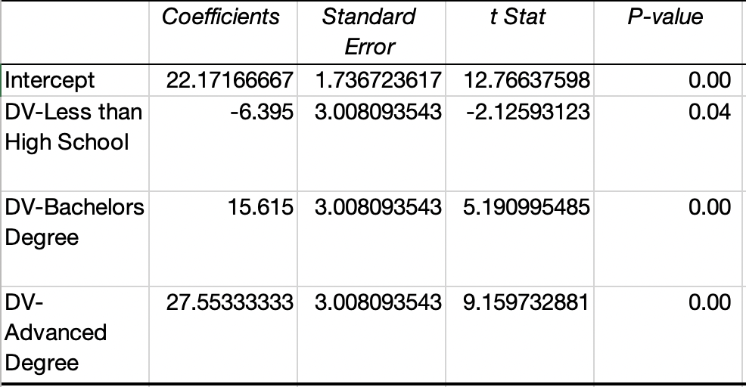
Continued Regression for Level of Education
Regression with less than high school, bachelors and advanced degree
Once we took out high school and re-did the regression
At this point, we did not need to calculate our regression further as our p-values were all under 0.05
It is clear that
If your education level is less than high school you make $6.40 less relative to the other education level
If you have a bachelor's degree you make $15.62 more relative to the other education level
And if you have an advanced degree you make $27.55 more relative to the other factors

Slide 14
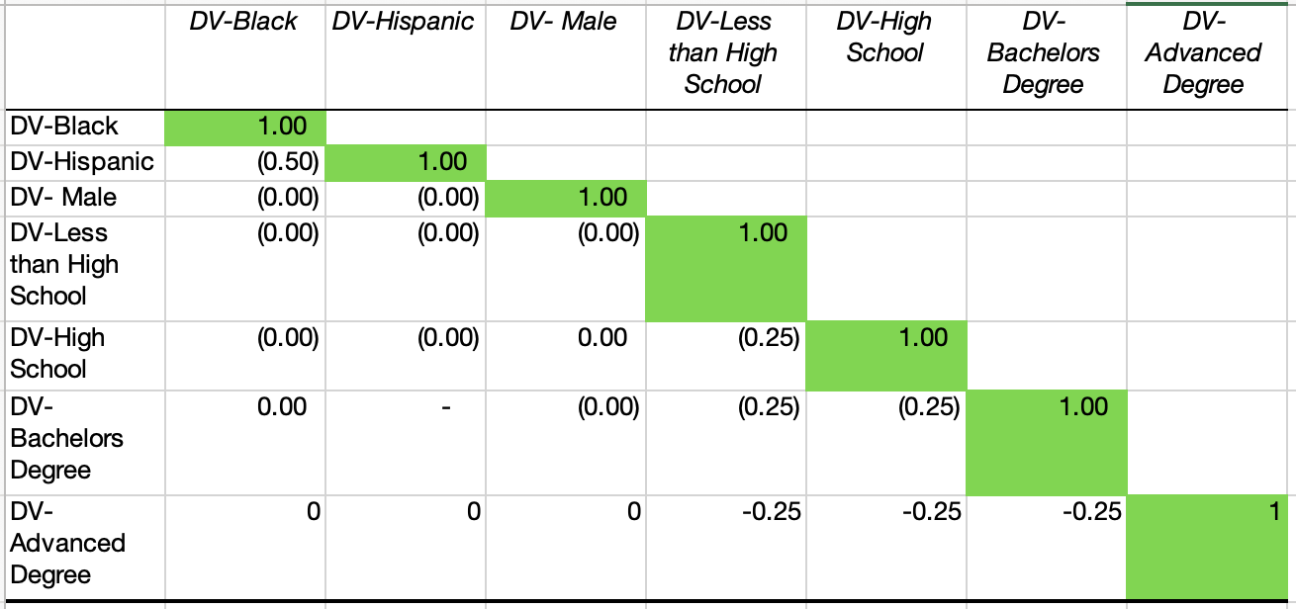
Collinearity
Collinearity with base cases
No correlation between any of our dependent variables
They all individually affect the hourly wage, but not each other

Slide 15
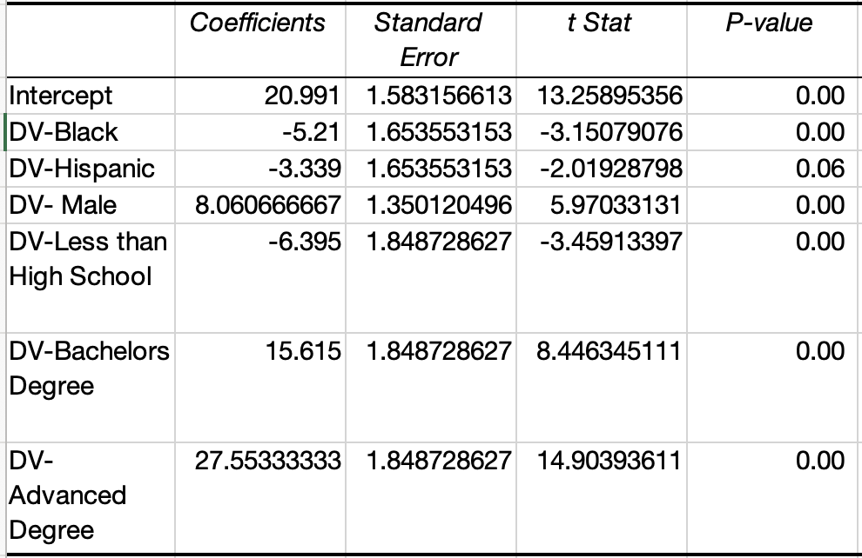
Regression with no base cases
Regression with no base cases
Big picture
Ran regression with all base cases
Removed high school as it had the biggest p-value
This was the result

Slide 16
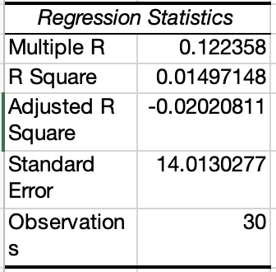
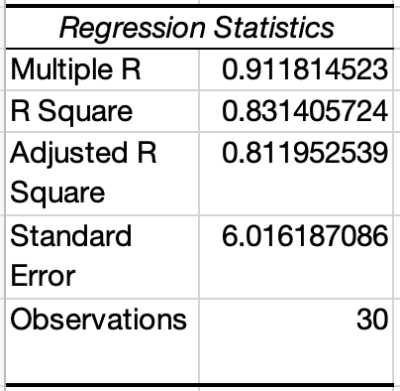
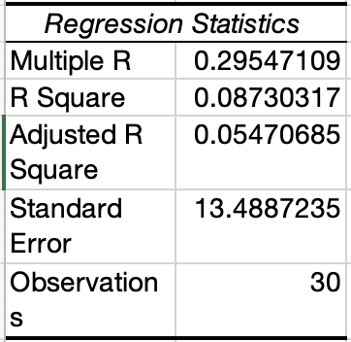
R^2 Analysis
Race
Education Level
A R-squared above 0.7 would generally be seen as showing a high level of correlation
As we can see, the highest R^2 is the education level
Meaning it is the most significant variable affecting the hourly wage
Gender

Slide 17
Conclusion
Which factor had the greatest impact on a person’s hourly wage?
Which factor had the least impact on a person’s hourly wage?
Education level had the greatest impact
R^2 was the highest with a value of 0.83
Specifically having an advanced degree has the greatest impact
A person with an advanced degree makes $28 more relative to any other education level
Race has the smallest impact
R^2 was the smallest with a value of 0.01
Specifically, being Hispanic had the least impact
If you were Hispanic your hourly wage was $3.34 less relative to other races, this was the smallest coefficient we came across

Slide 18
Works Cited
https://www.kaggle.com/datasets/asaniczka/wages-by-education-in-the-usa-1973-2022

